Slide 1
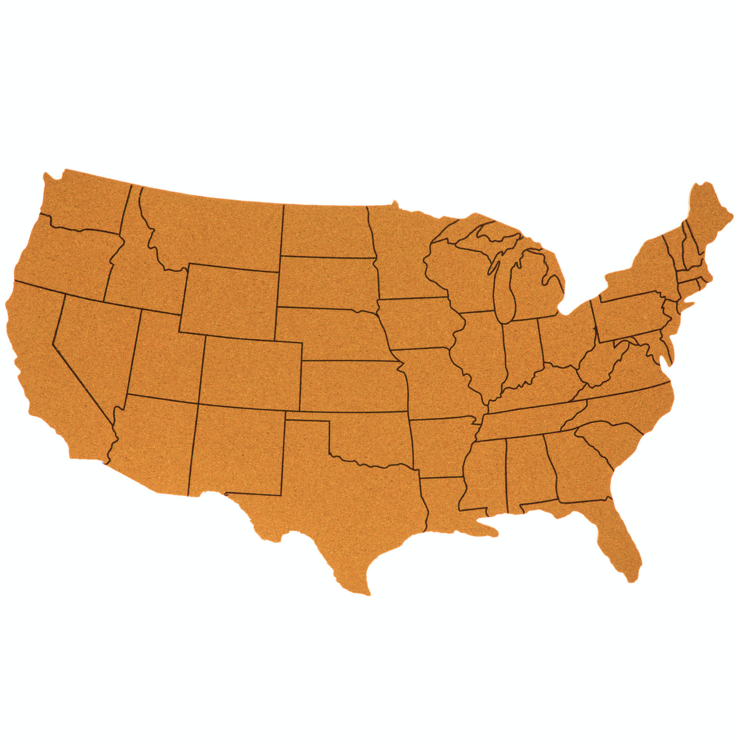

US TRAFFIC ACCIDENTS ANALYSIS
Kemen Goïcoechea
Luis Marés de la Cruz
Caridad Arroyo Arévalo
CSP 571 – FALL 2021

Slide 2
Index
Introduction
Data Preprocessing
Exploratory Data Analysis
Data Mining
Conclusions

Slide 3
Introduction
Data Preprocessing
Exploratory Data Analysis
Data Mining
Conclusions
Introduction
1,516,064
observations
US Accidents:
A Countrywide Traffic Accident Dataset
DATA SET
47 features
MAIN PURPOSES
Determining which factors impact the most in traffic accidents
Creating a real-time prediction tool

Slide 4
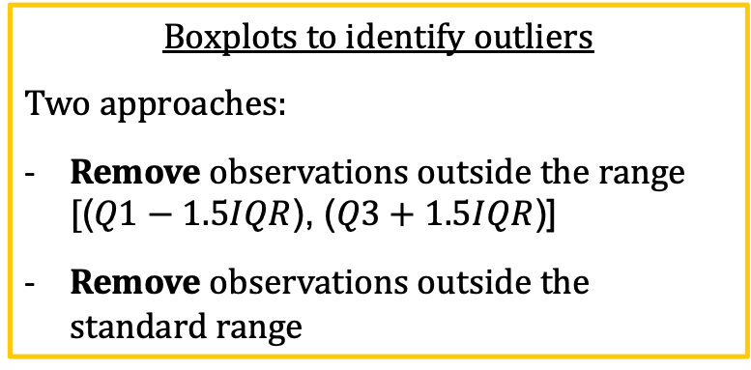
Introduction
Data Preprocessing
Exploratory Data Analysis
Data Mining
Conclusions
Data Cleaning
Empty Fields
Categorical attributes
Features with < 0.3% empty chars → Remove observations
Features with > 0.3% → Create category ‘Unknown’
Data set size:
1,516,064 x 47
Data set size:
1,244,342 x 46
NOISY DATA AND ANOMALIES
MISSING VALUES
NA Fields
Numerical attributes
Remove Number - 70% of the observations lack it
Linear interpolation for weather-related variables
Boxplots to identify outliers
Two approaches:
Remove observations outside the range [($Q1−1.5IQR$), ($Q3+1.5IQR$)]
Remove observations outside the standard range

Slide 5
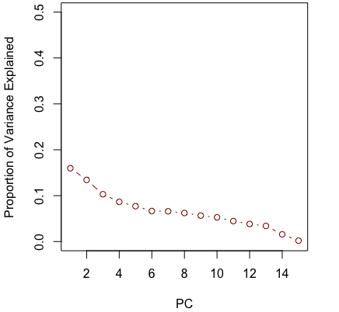
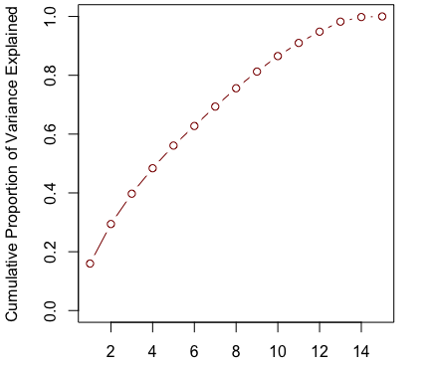
Data set size:
1,244,342 x 28
Introduction
Data Preprocessing
Exploratory Data Analysis
Data Mining
Conclusions
Data Reduction
INITIAL STAGE
SECOND STAGE
Carried out in this step
THIRD STAGE
Carried out in the Data Mining step
Determined as unnecessary
Computational issues
Scope is rearranged to the analysis of the impact of weather conditions on traffic accidents
Computational issues
Two strategies
DISCARDED
PCA
Only features related to weather are considered
A valid amount of variance (~80%) is explained with PCs up to 9
Reduction that would be reached is not high enough

Slide 6

Data set size:
1,244,342 x 27
Introduction
Data Preprocessing
Exploratory Data Analysis
Data Mining
Conclusions
Data Transformation
Appropriate data format
Start_Time – 4 new features are extracted: Year, Month, Date and Time
Zipcode – value reduced to the first five digits
Wind_Direction – values in different formats are set to the same one
Aggregation
Duration
End_Time - Start_Time
Lat
Mean(Start_Lat, End_Lat)
Lng
Mean(Start_Lng, End_Lng)
+ Remove
Weather_Timestamp – duplicate information
Country – one single value
Discretization and Normalization
Convert categorical features:
Character
Factor

Slide 7
Introduction
Data Preprocessing
Exploratory Data Analysis
Data Mining
Conclusions
Statistics
Objective:
Better understand the features
Familiarize with the dataset
Feature of interest: Severity
Severity | 1 | 2 | 3 | 4
Number of Observations | 21,111 | 1,011,432 | 132,817 | 78,982
Uneven distribution
Order of magnitude: 721.78 accidents daily

Slide 8
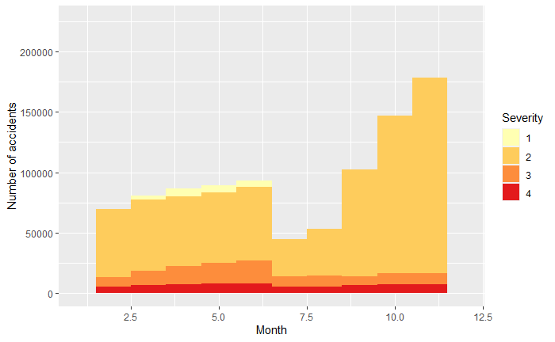
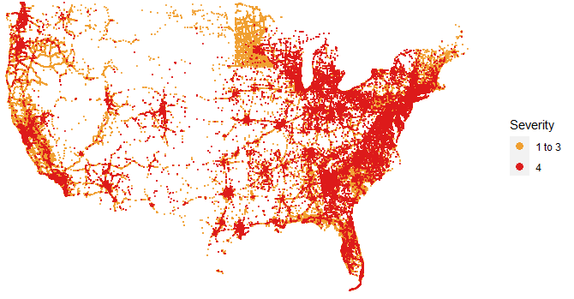
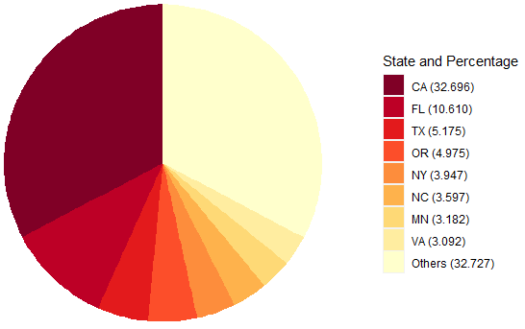
Introduction
Data Preprocessing
Exploratory Data Analysis
Data Mining
Conclusions
Visualizations
Objectives:
Understand the distribution of the features
Spot some shifts
Extract information about the domain

Slide 9
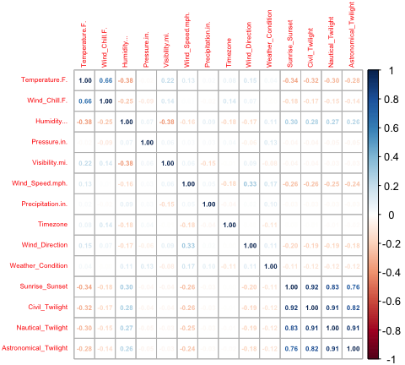
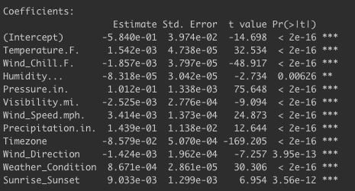
Introduction
Data Preprocessing
Exploratory Data Analysis
Data Mining
Conclusions
Model Training
PRIOR: Third stage of Data Reduction is carried out
Data set size:
1,244,342 x 15
FEATURE SELECTION
COLLINEARITY ASSESSMENT
SIGNIFICANCE EVALUATION
All the remaining features are statistically significant (p-value < 0.05)
Features with correlation above 0.75 are discarded
Data set size:
1,244,342 x 12

Slide 10
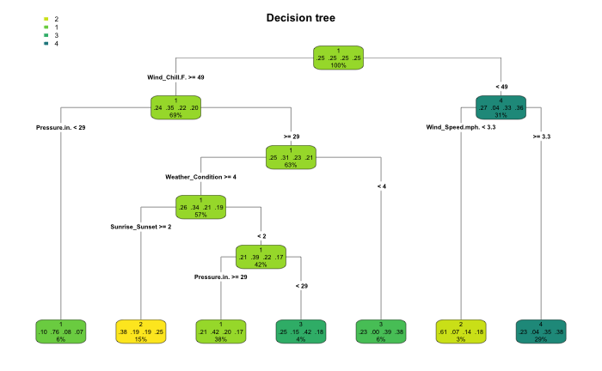
Introduction
Data Preprocessing
Exploratory Data Analysis
Data Mining
Conclusions
Model Training
1. Model building is too computationally expensive
CLASSIFICATION
Encountered issues
Data set is reduced to 20,000 observations
2. Class imbalance
Data set is balanced
1ST APPROACH
Pruned decision tree
2ND APPROACH
Random forest
mtry=3
Minimizes the OOB error (3.63%)
1st approach accuracy: 0.2805
2nd approach accuracy: 0.7245
Random forest is selected
Complexity parameter minimizes the cross-validated relative error

Slide 11
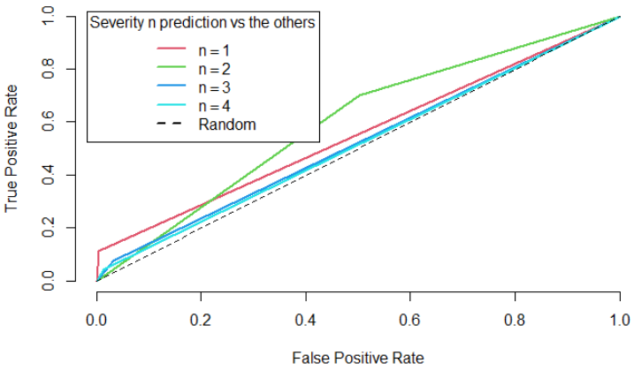
Introduction
Data Preprocessing
Exploratory Data Analysis
Data Mining
Conclusions
Model Validation
Objective:
Evaluation of the Random Forest model
Class | 1 | 2 | 3 | 4
Sensitivity | 15.19% | 85.34% | 21.69% | 14.46%
Specificity | 98.93% | 30.03% | 90.40% | 95.28%
Even with an accuracy of 72.58%, the model is heavily biased toward the class 2

Slide 12
Introduction
Data Preprocessing
Exploratory Data Analysis
Data Mining
Conclusions
Conclusions
The curse of dimensionality exists and can result in arduous and complex processes to obtain the desired results
This course has provided us a toolbox that we must learn to use, which will be achieved with practice.

Slide 13
US TRAFFIC ACCIDENTS ANALYSIS
Kemen Goïcoechea
Luis Marés de la Cruz
Caridad Arroyo Arévalo
CSP 571 – FALL 2021

